Slide 1


STUDYING THE MEOW MEOW OF MESOSCALE CATS
Master of Science in Environmental Meteorology
29° October 2024
Candidate: STORER Alessandro
Matriculation 240734
Supervisor: PASQUERO Claudia
Internal Supervisor: ZARDI Dino

Slide 2
TOPIC OF THE DAY
AIR – SEA INTERACTIONS

Slide 3
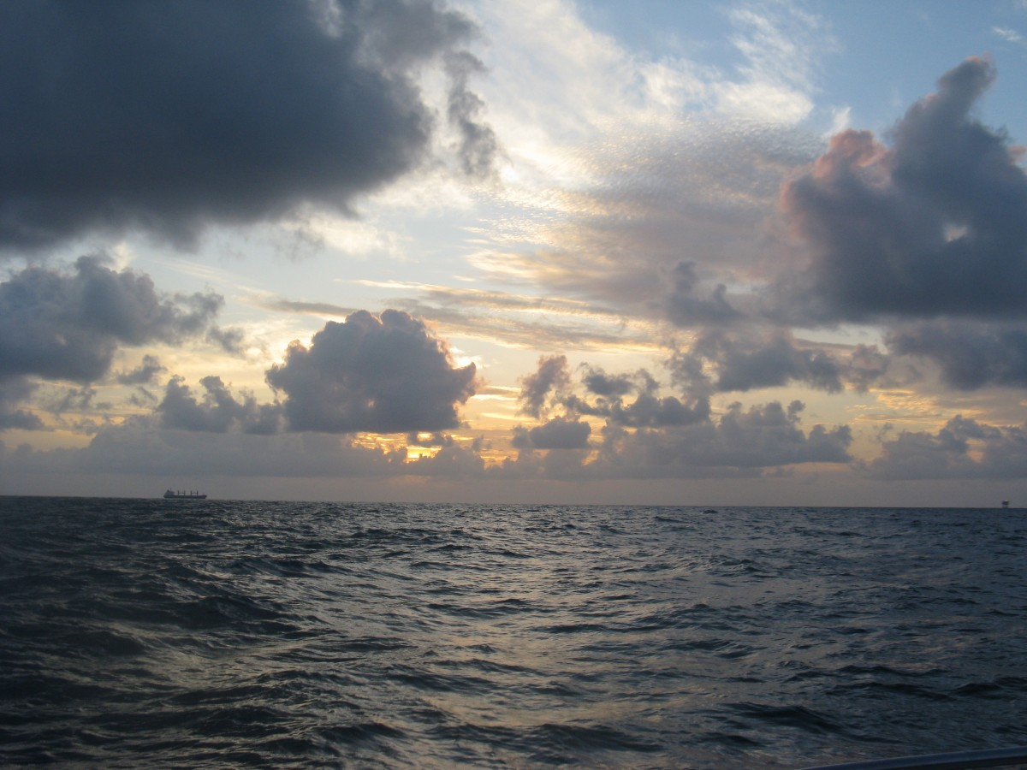
Humidity
Radiative balance
Convective
organization
CLIMATE
CO2 and heat uptake
Turbulent fluxes
Notes:
the coupling between marine shallow
trade-wind clouds and circulation is known to play a cen-
tral role in the uncertainty of the tropical cloud feedback and climate sensitivity estimated by models

Slide 4
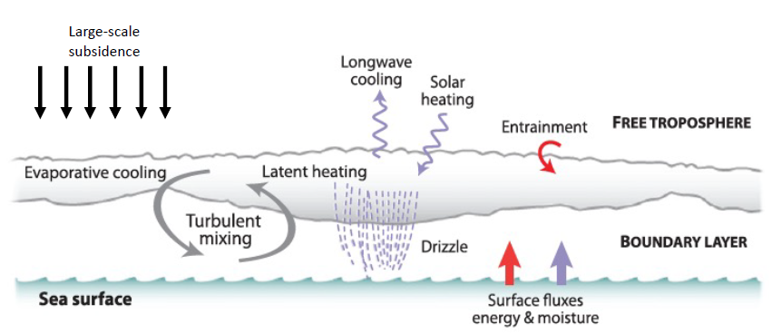
Credits: Allison Wing
WE CALL THIS
A COUPLED SYSTEM
Mettere magari un’immagine tratta da lavori su eurec4a

Slide 5
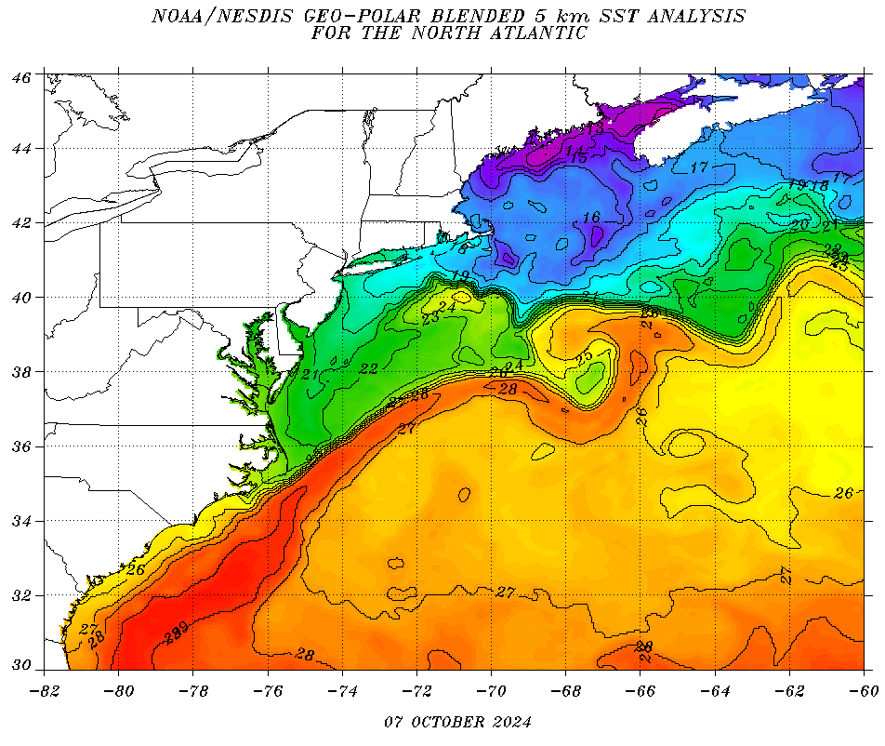
The Gulf Stream case

Slide 6
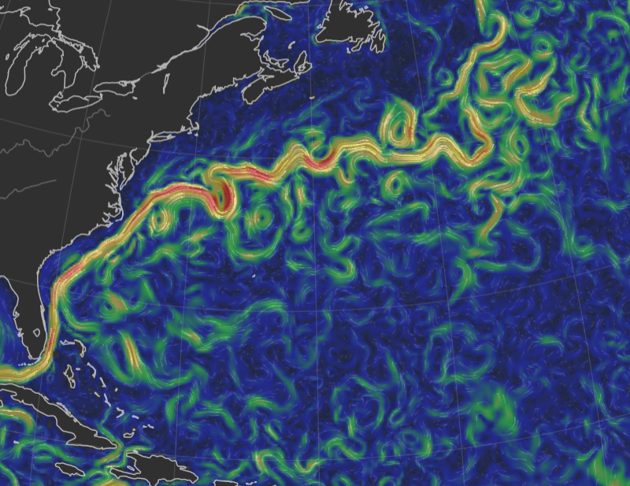
The Gulf Stream case
Reconstructed surface currents on 7th October: peaks (red shadings) correspond to approx. 1.5m/s
Source: https://earth.nullschool.net/

Slide 7
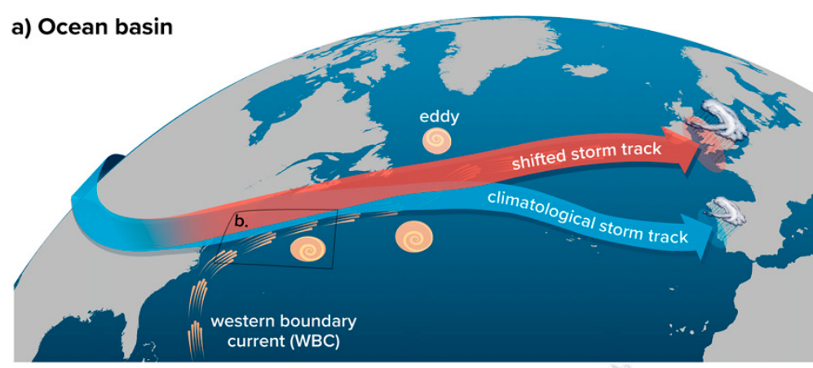
Seo et al. 2023

Slide 8
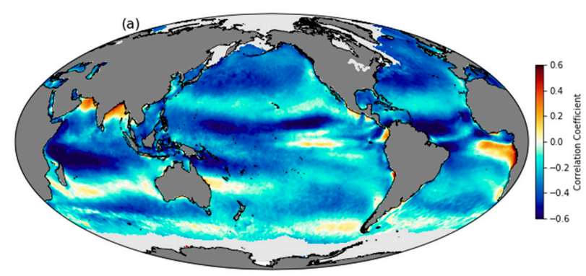
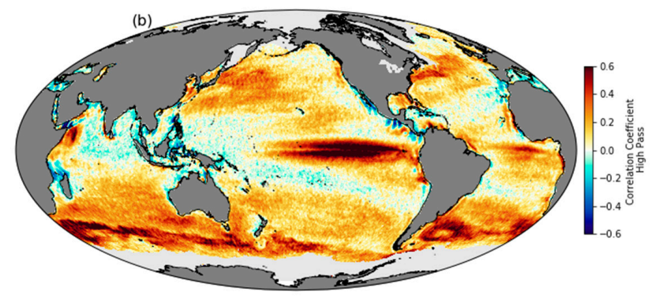
INTRODUCING THE LOCAL SCALE
Gentemann et al. 2020

Slide 11
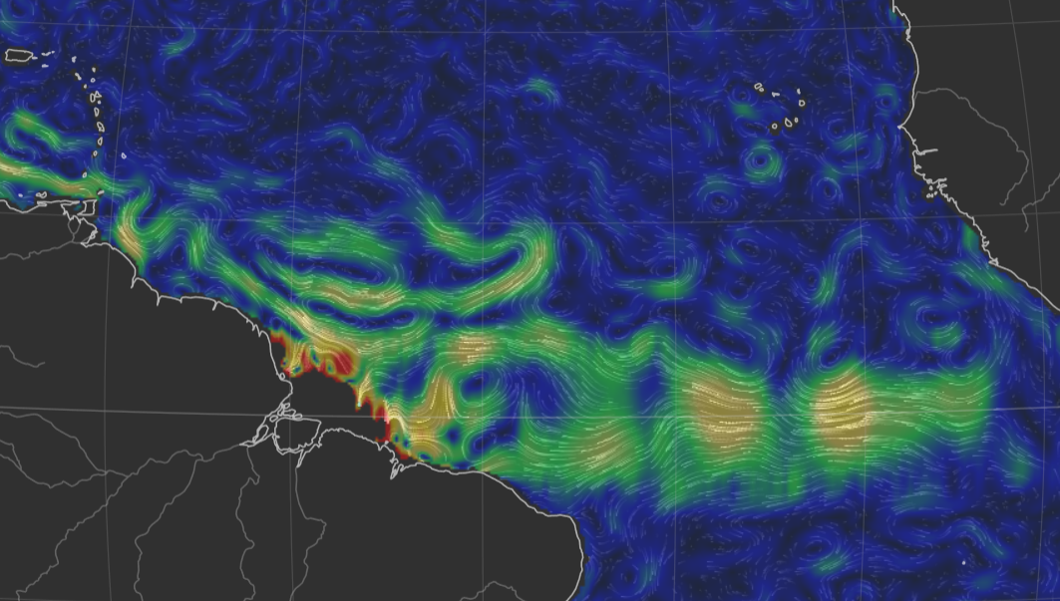
Reconstructed surface currents on 4th February 2020: peaks (yellow shadings) correspond to approx. 1m/s
Source: https://earth.nullschool.net/
Red box: the EUREC4A region
and computational domain

Slide 13
